Slide 1
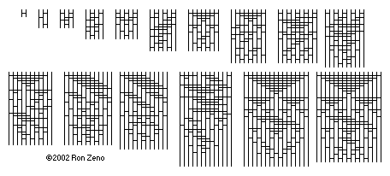
Theoretical Bounds on Sorting
Lecture 34 (Sorting 4)
CS61B, Spring 2024 @ UC Berkeley
Slides credit: Josh Hug
Notes:
http://www.angelfire.com/blog/ronz/Articles/999SortingNetworksReferen.html

Slide 2
Goal: How Hard is Sorting?
Goal: How Hard is Sorting?
Math Problem Warmup
Theoretical Bounds on Sorting
Simple Bounds for TUCS (the ultimate comparison sort)
Coin Puzzles
Puppy Cat Dog
The Sorting Lower Bound
Sounds of Sorting
Lecture 34, CS61B, Spring 2024

Slide 3
Sorts Summary
 | Memory | # Compares | Notes | Stable?
Heapsort | Θ(1) | Θ(N log N) | Bad caching (61C) | No
Insertion | Θ(1) | Θ(N²) | Best for almost sorted and N < 15 | Yes
Mergesort | Θ(N) | Θ(N log N) | Fastest stable sort | Yes
Quicksort LTHS | Θ(log N) | Θ(N log N) expected | Fastest sort | No
This is due to the cost of tracking recursive calls by the computer, and is also an “expected” amount. The difference between log N and constant memory is trivial.
You can create a stable Quicksort. However, using unstable partitioning schemes (like Hoare partitioning) and using randomness to avoid bad pivots tend to yield better runtimes.

Slide 4
Sorting
Sorting is a foundational problem.
Obviously useful for putting things in order.
But can also be used to solve other tasks, sometimes in non-trivial ways.
Sorting improves duplicate finding from a naive N² to N log N.
Sorting improves 3SUM from a naive N³ to N².
There are many ways to sort an array, each with its own interesting tradeoffs and algorithmic features.
Today we’ll discuss the fundamental nature of the sorting problem itself: How hard is it to sort?

Slide 5
Comparison Sorts (Your Answer)
For today, we'll only consider comparison sorts, which sort a list of items using only two operations:
compareTo, which compares two items and says which one is greater
swap, which swaps the indices of two items in the array
This allows our sorting algorithm to work on any Comparable object
Examples of comparison sorts:
Insertion sort, Selection sort, Bubble sort, Mergesort, Quicksort
Examples of non-comparison sorts:
Counting sort, Radix sort,

Slide 6
Comparison Sorts (My Answer)
For today, we'll only consider comparison sorts, which sort a list of items using only two operations:
compareTo, which compares two items and says which one is greater
swap, which swaps the indices of two items in the array
This allows our sorting algorithm to work on any Comparable object
Examples of comparison sorts (ones highlighted in blue haven't been covered yet): Heapsort, Mergesort, Quicksort, Insertion Sort, Selection Sort, Bubble Sort
Examples of non-comparison sorts: Radix Sort, Sleepsort, Gravity Sort, BOGOsort

Slide 7
Math Problem Warmup
Goal: How Hard is Sorting?
Math Problem Warmup
Theoretical Bounds on Sorting
Simple Bounds for TUCS (the ultimate comparison sort)
Coin Puzzles
Puppy Cat Dog
The Sorting Lower Bound
Sounds of Sorting
Lecture 34, CS61B, Spring 2024

Slide 8
A Math Problem out of Nowhere
Consider the functions N! and (N/2)^{N/2}
Is N! ∈ Ω((N/2)^{N/2})? Prove your answer.
Recall that ∈ Ω can be informally be interpreted to mean ≥
In other words, does factorial grow at least as quickly as (N/2)^{N/2}?

Slide 9
A Math Problem out of Nowhere
Consider the functions N! and (N/2)^{N/2}
Is N! ∈ Ω((N/2)^{N/2})? Prove your answer.
10!
10 * 9 * 8 * 7 * 6 * … * 1
5⁵
5 * 5 * 5 * 5 * 5
N! > (N/2)^{N/2}, for large N, therefore N! ∈ Ω((N/2)^{N/2})

Slide 10
Another Math Problem
Given: N! > (N/2)^{N/2}, which we used to prove our answer to the previous problem.
Show that log(N!) ∈ Ω(N log N).
Recall: log means an unspecified base.
Remember your log rules:
log(A^{B}) = B * log(A)
log(A*B) = log(A) + log(B)
log_{A}(B) = log(B)/log(A)

Slide 11
Another Math Problem
Given that N! > (N/2)^{N/2}
Show that log(N!) ∈ Ω(N log N).
We have that N! > (N/2)^{N/2}
Taking the log of both sides, we have that log(N!) > log((N/2)^{N/2}).
Bringing down the exponent we have that log(N!) > N/2 log(N/2).
Using log rules we have that log(N!) > N/2 (log(N) - log(2))
Discarding the unnecessary constants, we have log(N!) ∈ Ω(N log (N/2)).
From there, we have that log(N!) ∈ Ω(N log N).
In other words, log(N!) grows at least as quickly as N log N.

Slide 12
Last Math Problem
In the previous problem, we showed that log(N!) ∈ Ω(N log N).
Now show that N log N ∈ Ω(log(N!)).

Slide 13
Last Math Problem
Show that N log N ∈ Ω(log(N!))
Proof:
log(N!) = log(N) + log(N-1) + log(N-2) + …. + log(1)
N log N = log(N) + log(N) + log(N) + … log(N)
Therefore N log N ∈ Ω(log(N!))

Slide 14
Omega and Theta: yellkey.com
Given:
N log N ∈ Ω(log(N!))
log(N!) ∈ Ω(N log N)
Which of the following can we say?
N log N ∈ Θ(log N!)
log N! ∈ Θ(N log N)
Both A and B
Neither
Notes:
https://docs.google.com/forms/d/e/1FAIpQLSc7OfRNg4Vj8G3h4tuA6VL30gnD8gjWbThyRjiDWmAR2B8f1g/viewform

Slide 15
Omega and Theta
Given:
N log N ∈ Ω(log(N!))
log(N!) ∈ Ω(N log N)
Which of the following can we say?
N log N ∈ Θ(log N!)
log N! ∈ Θ(N log N)
Both A and B
Neither
Informally: N log N ≥ log(N!)
Informally: log(N!) ≥ N log N
Informally: N log N = log(N!)

Slide 16
Summary
We’ve shown that log(N!) ∈ Θ(N log N).
In other words, these two functions grow at the same rate asymptotically.
As for why we did this, we will see in a little while...

Slide 17
Simple Bounds for TUCS (the ultimate comparison sort)
Goal: How Hard is Sorting?
Math Problem Warmup
Theoretical Bounds on Sorting
Simple Bounds for TUCS (the ultimate comparison sort)
Coin Puzzles
Puppy Cat Dog
The Sorting Lower Bound
Sounds of Sorting
Lecture 34, CS61B, Spring 2024

Slide 18
Sorting
We have shown several sorts to require Θ(N log N) worst case time.
Can we build a better sorting algorithm?
Let the ultimate comparison sort (TUCS) be the asymptotically fastest possible comparison sorting algorithm, possibly yet to be discovered, and let R(N) be its worst case runtime.
Give the best Ω and O bounds you can for R(N).
It might seem strange to give Ω and O bounds for an algorithm whose details are completely unknown, but you can, I promise!

Slide 19
Sorting
We have shown several sorts to require Θ(N log N) worst case time.
Can we build a better sorting algorithm?
Let the ultimate comparison sort (TUCS) be the asymptotically fastest possible comparison sorting algorithm, possibly yet to be discovered, and let R(N) be its worst case runtime.
O(N log N)
Worst case run-time of TUCS, R(N) is O(N log N).
Obvious: Mergesort is Θ(N log N) so R(N) can’t be worse!
Worst case run-time of TUCS, R(N) is Ω(1).
Obvious: Problem doesn’t get easier with N.
Can we make a stronger statement than Ω(1)?
Ω(1)
TUCS Worst
Case Θ Runtime

Slide 20
Sorting
Let TUCS be the asymptotically fastest possible comparison sorting algorithm, possibly yet to be discovered.
Worst case run-time of TUCS, R(N) is O(N log N). Why?
Worst case run-time of TUCS, R(N) is also Ω(N).
Have to at least look at every item.
O(N log N)
Ω(N)
TUCS Worst
Case Θ Runtime

Slide 21
Sorting
We know that TUCS “lives” between N and N log N.
Worst case asymptotic runtime of TUCS is between Θ(N) and Θ(N log N).
Can we make an even stronger statement on the lower bound?
With a clever argument, yes (as we’ll see soon see).
Spoiler alert: It will turn out to be Ω(N log N)
This lower bound means that across the infinite space of all possible ideas that any human might ever have for sorting using sequential comparisons, NONE has a worst case runtime that is better than Θ(N log N).
O(N log N)
Ω(N)
TUCS Worst
Case Θ Runtime

Slide 22
Coin Puzzles
Goal: How Hard is Sorting?
Math Problem Warmup
Theoretical Bounds on Sorting
Simple Bounds for TUCS (the ultimate comparison sort)
Coin Puzzles
Puppy Cat Dog
The Sorting Lower Bound
Sounds of Sorting
Lecture 34, CS61B, Spring 2024

Slide 23

9 Coins
Suppose we have nine coins that are all identical in appearance and weight. However, one of them is a counterfeit coin, and weighs slightly more than the other 8.
We have a scale that can be used to compare two sets of coins at a time, but we can only use it twice. How can we determine the counterfeit coin?
1
2
3
4
5
6
7
8
9

Slide 24
9 Coins: Step 1
Many solutions, but here's the classic one:
Step 1: Compare coins 123 vs 456
There are three cases:
1: Left side heavier 2: Right side heavier
3: The two are equal
1
2
3
4
5
6
7
8
9

Slide 25
9 Coins: Step 2 in Case 1
In case 1: The heavier coin is either 1, 2, or 3
Step 2.1: Compare coins 1 vs 2
There are three possibilities:
1: Left side heavier 2: Right side heavier
Coin 1 is counterfeit Coin 2 is counterfeit
3: The two are equal
Coin 3 is counterfeit
1
2
3

Slide 26
9 Coins: Step 2 in Case 2
In case 2: The heavier coin is either 4, 5, or 6
Step 2.2: Compare coins 4 vs 5
There are three possibilities:
1: Left side heavier 2: Right side heavier
Coin 4 is counterfeit Coin 5 is counterfeit
3: The two are equal
Coin 6 is counterfeit
4
5
6

Slide 27
9 Coins: Step 2 in Case 3
In case 3: The heavier coin is either 7, 8, or 9
Step 2.3: Compare coins 7 vs 8
There are three possibilities:
1: Left side heavier 2: Right side heavier
Coin 7 is counterfeit Coin 8 is counterfeit
3: The two are equal
Coin 9 is counterfeit
7
8
9

Slide 28
9 Coins: Decision Tree
The full decision tree for 9 coins:
123 vs 456?
>
=
<
1 vs 2?
7 vs 8?
4 vs 5?
7 fake
9 fake
8 fake
1 fake
3 fake
2 fake
4 fake
6 fake
5 fake

Slide 29
9 Coins: Validation
To verify that our scheme works, let's check every single case.
There are nine "universes" that we could start in (1 is counterfeit, 2 is counterfeit, etc.). We can verify that in each universe, we yield the correct result
1
2
3
1
2
3
1
2
3
4
5
6
4
5
6
4
5
6
7
8
9
7
8
9
7
8
9
1
2
3
1
2
3
1
2
3
4
5
6
4
5
6
4
5
6
7
8
9
7
8
9
7
8
9
1
2
3
1
2
3
1
2
3
4
5
6
4
5
6
4
5
6
7
8
9
7
8
9
7
8
9

Slide 30
9 Coins: Decision Tree in Universe 1
The full decision tree in Universe 1:
123 vs 456?
>
=
<
1 vs 2?
7 vs 8?
4 vs 5?
7 fake
9 fake
8 fake
1 fake
3 fake
2 fake
4 fake
6 fake
5 fake

Slide 31
9 Coins: Validation
To verify that our scheme works, let's check every single case.
There are nine "universes" that we could start in (1 is counterfeit, 2 is counterfeit, etc.). We can verify that in each universe, we yield the correct result

Slide 32
9 Coins: Validation
To verify that our scheme works, let's check every single case.
There are nine "universes" that we could start in (1 is counterfeit, 2 is counterfeit, etc.). We can verify that in each universe, we yield the correct result
1 fake
2 fake
3 fake
4 fake
5 fake
6 fake
7 fake
8 fake
9 fake

Slide 33
10 Coins
With 9 coins, we can find the counterfeit coin in 2 weighings.
Question: Can we do this with 10 coins?
1
2
3
4
5
6
7
8
9
10

Slide 34
10 Coins: Proof of impossibility
No: With a two-layer decision tree, we have at most 9 leaves, but there are 10 possible universes.
>
=
<

Slide 35
10 Coins: Proof of impossibility
Therefore, at least one leaf must have two universes that lead there
>
=
<

Slide 36
10 Coins: Proof of impossibility
In that leaf, regardless of the two universes that end up there, we'll be wrong in at least one of those universes.
Therefore it is impossible to guarantee a determination on which of 10 coins is counterfeit with only 2 weighings.
6 Fake
1
2
3
4
5
1
2
3
4
5
6
7
8
9
10
6
7
8
9
10

Slide 37
More Coins
Each weighing triples the number of cases we can manage. So with N weighings, we can have at most 3^{N} leaves in our decision tree. This means that if we have >3^{N} coins, we have proven that no algorithm exists.
Does the converse hold true?
If we have X <= 3^{N} coins, does our proof guarantee an algorithm exist?
In this case, we can find an algorithm for X coins as long as the condition holds, but this isn't necessarily true (see skipped slides for a counterexample).
1
2
3
4
5
6
…
…
…
X

Slide 38
12/13 Coins: yellkey.com
This time, the counterfeit coin can either be slightly lighter, or slightly heavier than all the other coins. We want to know both which coin is counterfeit, and whether it was heavier, or lighter. This time, we can use the scale 3 times, so in theory, we can handle 27 universes. Which of the following are possible?
12 coins (24 universes)
12 coins if we have a 13th reference coin that is guaranteed to be real
12 coins if we don't care about whether the counterfeit is heavier or lighter
13 coins (26 universes)
13 coins if we have a 14th reference coin that is guaranteed to be real
13 coins if we don't care about whether the counterfeit is heavier or lighter
1
2
3
4
5
6
7
8
9
A
B
C
D
R

Slide 39
12 Coins: Solution
For 12 coins, this is possible (and by extension the other 12-coin puzzles)
1234 vs 5678
125 vs 346
9A vs 1B
156 vs 278
1 vs 2
1 vs 7
3 vs 4
9 vs A
1 vs C
9 vs A
7 vs 8
1 vs 3
5 vs 6

Slide 40
13 Coins: Proof of Impossibility
For 13 coins, this is impossible. We do have 26 < 27 universes, but we also need our first weighing to narrow down to 9 or fewer universes. Our first weighing needs to compare an equal number of coins, so we can check all possible weighings to show that no first weighing splits our 27 universes into groups 9 or smaller (the below is the closest we get)
1234 vs 5678
8 universes
10 universes
8 universes

Slide 41
13 Coins with a Reference
For 13 coins with a reference, this is possible, because the reference lets us split into 9-8-9 universes.
12345 vs 6789R
126 vs 347
Same as 12 coin
126 vs 347
1 vs 2
8 vs 9
3 vs 4
3 vs 4
8 vs 9
1 vs 2

Slide 42
13 Coins with only Identification
For 13 coins when we only care about identifying the counterfeit, it's possible using the solution we found for 12 coins. If we follow the decision tree, we find that two universes do end up at the same leaf.
But because they both have the same return value, our algorithm still works.
Universe where D is heavy Universe where D is light
D Fake
1
2
3
4
5
1
2
3
4
5
6
7
8
9
A
6
7
8
9
A
B
C
D
B
C
D

Slide 43
12/13 Coins
Universe counting is a useful tool to find lower bounds of algorithms, but it has some caveats:
You can't show that a solution does exist; only that a solution doesn't exist
If multiple universes yield the same result, they only count as 1 universe
12 coins (24 universes)
12 coins if we have a 13th reference coin that is guaranteed to be real
12 coins if we don't care about whether the counterfeit is heavier or lighter
13 coins (26 universes)
13 coins if we have a 14th reference coin that is guaranteed to be real
13 coins if we don't care about whether the counterfeit is heavier or lighter
1
2
3
4
5
6
7
8
9
10
11
12
13
R

Slide 44
Universe Counting
In general, any decision tree with K layers and a branching factor of R (3 in this case) has at most R^{K} leaves, so it can handle a problem with up to R^{K} universes (where each universe yields a different expected return value).
If we flip this around, that means that if we have a problem that has R^{K} universes, the decision tree must have at least K layers
Or if we have a problem with K universes, the decision tree must have Ω(log K) layers

Slide 45
Puppy, Cat, Dog
Goal: How Hard is Sorting?
Math Problem Warmup
Theoretical Bounds on Sorting
Simple Bounds for TUCS (the ultimate comparison sort)
Coin Puzzles
Puppy Cat Dog
The Sorting Lower Bound
Sounds of Sorting
Lecture 34, CS61B, Spring 2024

Slide 46
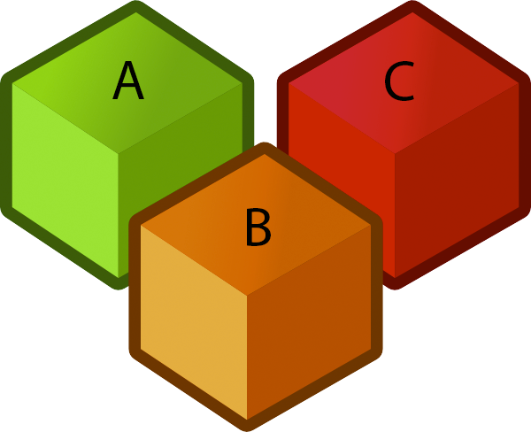



The Game of Puppy, Cat, Dog
Suppose we have a puppy, a cat, and a dog, each in an opaque soundproof box labeled A, B, and C. The puppy is lighter than the cat, and the cat is lighter than the dog. As before, we have a scale, and we want to minimize the number of times we use the scale (unlike before, we never get equality on this scale, because all the animals are different weights). Our goal is to write A, B, C in order of weight.
Notes:
Cubes: http://www.clker.com/cliparts/6/9/3/2/1197122947130754155jean_victor_balin_Cubes.svg.hi.png
Scale: http://www.clipartbest.com/cliparts/94T/bAe/94TbAejig.png
Puppy:http://assets.nydailynews.com/polopoly_fs/1.1245686!/img/httpImage/image.jpg_gen/derivatives/article_970/afp-cute-puppy.jpg
Cat: http://animalia-life.com/cat.html
Dog: http://animalia-life.com/dogs.html

Slide 47
The Game of Puppy, Cat, Dog, yellkey.com
What is our minimum decision tree height for the game of Puppy, Cat, Dog (according to our universe bound)?
3
4
5
6
Notes:
https://docs.google.com/forms/d/e/1FAIpQLSfwjP1UTp38YwotowMSNR169vrEFAPzckl_v83omPc2tf_9KQ/viewform

Slide 48
The Game of Puppy, Cat, Dog
What is our minimum decision tree height for the game of Puppy, Cat, Dog (according to our universe bound)?
3
4
5
6
Proof:
If N=3, we have 3! = 6 different permutations of the animals, and each permutation yields a different answer. Therefore we have 6 universes
So we need a binary tree with at least 6 leaves.
How many levels minimum? 2² = 4 is too small, and 2³=8 is large enough, so we need at least 3 layers.

Slide 49
Puppy, Cat, Dog - Decision Tree
The full decision tree for puppy, cat, dog:
Is a < b?
No
Yes
Is a < c?
Is b < c?
No
Yes
No
Yes
a: puppy
b: cat
c: dog
Is b < c?
b a c
Is a < c?
a b c
No
Yes
No
Yes
c: puppy
a: cat
b: dog
a: puppy
c: cat
b: dog
c b a
b c a
c a b
a c b

Slide 50
Generalizing Puppy, Cat, Dog
How many questions would you need to ask to definitely solve the generalized “puppy, cat, dog” problem for N items?
Give your answer in big Omega notation.

Slide 51
Generalizing Puppy, Cat, Dog
How many questions would you need to ask to definitely solve the generalized “puppy, cat, dog” problem for N items?
Give your answer in big Omega notation.
For N, we have the following argument:
For N animals, we have N! universes.
So we need at least ceiling(lg(N!)) levels, which is Ω(log(N!))
Don't know for certain that we can attain that bound, so we can only say an Omega bound
lg just means log₂ (log base 2)
Answer: Ω(log(N!))

Slide 52
Generalizing Puppy, Cat, Dog
Finding an optimal decision tree for the generalized version of puppy, cat, dog (e.g. N=6: puppy, cat, dog, monkey, walrus, elephant) is an open problem in mathematics.
(To my knowledge) Best known trees known for N=1 through 15 and N=22:
For more, see: http://oeis.org/A036604
Deriving a sequence of yes/no questions to identify puppy, cat, dog is hard. An alternate approach to solving the puppy, cat, dog problem:
Use a sorting algorithm!

Slide 53
Reducing Puppy, Cat, Dog to Sorting
Arrange the boxes in a row from A to Z
Create a class Box implements Comparable
For the compareTo method:
Use the scale to compare the given boxes and return the result
For the swap method:
Swap the two boxes
Sort the array. This reorders the boxes from lightest to heaviest.
Read out the letters on the boxes from lightest to heaviest

Slide 54
Sorting, Coins, Puppies, Cats, and Dogs
Why do we care about these coins and (no doubt adorable) critters?
A solution to the sorting problem also provides a solution to puppy, cat, dog.
In other words, puppy, cat, dog reduces to sorting.
Thus, any lower bound on difficulty of puppy, cat, dog must ALSO apply to sorting.
Physics analogy: Climbing a hill with your legs (CAHWYL) is one way to solve the problem of getting up a hill (GUAH).
Any lower bound on energy to GUAH must also apply to CAHWYL.
Example bound: Takes m*g*h energy to climb hill, so using legs to climb the hill takes at least m*g*h energy.

Slide 55
The Sorting Lower Bound
Goal: How Hard is Sorting?
Math Problem Warmup
Theoretical Bounds on Sorting
Simple Bounds for TUCS (the ultimate comparison sort)
Coin Puzzles
Puppy Cat Dog
The Sorting Lower Bound
Sounds of Sorting
Lecture 34, CS61B, Spring 2024

Slide 56
Sorting Lower Bound
We have a lower bound on puppy, cat, dog: namely that it takes Ω(log(N!)) comparisons to solve such a puzzle in the worst case.
Since sorting with comparisons can be used to solve puppy, cat, dog, then sorting also takes Ω(log(N!)) comparisons in the worst case.
Or in other words:
Any sorting algorithm using comparisons, no matter how clever, must use at least k = lg(N!) compares to find the correct permutation. So even TUCS takes at least lg(N!) comparisons.
lg(N!) is trivially Ω(log(N!)), so TUCS must take Ω(log(N!)) time.
So, how does log(N!) compare to N log N?
O(N log N)
Ω(log(N!))
TUCS Worst
Case Θ Runtime

Slide 57
Another Math Problem
Earlier, we showed that log(N!) ∈ Ω(N log N) using the proof below.
In other words, log(N!) grows at least as quickly as N log N.
Proof from earlier that log(N!) ∈ Ω(N log N):
We know that N! ≥ (N/2)^{N/2}.
Taking the log of both sides, we have that log(N!) ≥ log((N/2)^{N/2}).
Bringing down the exponent we have that log(N!) ≥ N/2 log(N/2).
Discarding unnecessary constants, we have log(N!) ∈ Ω(N log N)
Recall that changing base is just multiplying by a constant.

Slide 58
The Sorting Lower Bound (Finally)
Since TUCS is Ω(lg N!) and lg N! is Ω(N log N), we have that TUCS is Ω(N log N).
Any comparison based sort requires at least order N log N comparisons in its worst case.
O(N log N)
Ω(N log N)
TUCS Worst
Case Θ Runtime

Slide 59
The Sorting Lower Bound (Finally)
Since TUCS is Ω(lg N!) and lg N! is Ω(N log N), we have that TUCS is Ω(N log N).
Any comparison based sort requires at least order N log N comparisons in its worst case.
Proof summary:
Puppy, cat, dog is Ω(lg N!), i.e. requires lg N! comparisons.
TUCS can solve puppy, cat, dog, and thus takes Ω(lg N!) compares.
lg(N!) is Ω(N log N)
This was because N! is Ω(N/2)^{N/2}
Informally: TUCS ≥ puppy, cat, dog ≥ log N! ≥ N log N
O(N log N)
Ω(N log N)
TUCS Worst
Case Θ Runtime

Slide 60
Optimality
 | Memory | # Compares | Notes | Stable?
Heapsort | Θ(1) | Θ(N log N) | Bad caching (61C) | No
Insertion | Θ(1) | Θ(N²) | Best for almost sorted and N < 15 | Yes
Mergesort | Θ(N) | Θ(N log N) | Fastest stable sort | Yes
Quicksort LTHS | Θ(log N) | Θ(N log N) expected | Fastest sort | No
The punchline:
Our best sorts have achieved absolute asymptotic optimality.
Mathematically impossible to sort using fewer comparisons.
Note: Randomized quicksort is only probabilistically optimal, but the probability is extremely high for even modest N. Are you worried about quantum teleportation? Then don’t worry about Quicksort.

Slide 61
Next Time...
Today we proved that any sort that uses comparisons has runtime Ω(N log N).
Next time we’ll discuss how we can sort in Θ(N) time.
Not impossible, just can’t be a comparison sort!

Slide 62
Sounds of Sorting
Goal: How Hard is Sorting?
Math Problem Warmup
Theoretical Bounds on Sorting
Simple Bounds for TUCS (the ultimate comparison sort)
Coin Puzzles
Puppy Cat Dog
The Sorting Lower Bound
Sounds of Sorting
Lecture 34, CS61B, Spring 2024

Slide 63
Sounds of Sorting Algorithms (of 125 items)
Starts with selection sort: https://www.youtube.com/watch?v=kPRA0W1kECg
Insertion sort: https://www.youtube.com/watch?v=kPRA0W1kECg&t=0m9s
Quicksort: https://www.youtube.com/watch?v=kPRA0W1kECg&t=0m38s
Mergesort: https://www.youtube.com/watch?v=kPRA0W1kECg&t=1m05s
Heapsort: https://www.youtube.com/watch?v=kPRA0W1kECg&t=1m28s
LSD sort: https://www.youtube.com/watch?v=kPRA0W1kECg&t=1m54s [coming in a future lecture]
MSD sort: https://www.youtube.com/watch?v=kPRA0W1kECg&t=2m10s [coming in a future lecture]
Shell’s sort: https://www.youtube.com/watch?v=kPRA0W1kECg&t=3m37s [bonus from an earlier lecture]
One Hour of various sorts: https://www.youtube.com/watch?v=8MsTNqK3o_w
Questions to ponder (later… after class):
How many items for selection sort?
Why does insertion sort take longer / more compares than selection sort?
At what time stamp does the first partition complete for Quicksort?
Could the size of the input to mergesort be a power of 2?
What do the colors mean for heapsort?
How many characters are in the alphabet used for the LSD sort problem? (after we learn about it)
How many digits are in the keys used for the LSD sort problem? (after we learn about it)

Slide 64
Extra: Sorting Implementations
Goal: How Hard is Sorting?
Math Problem Warmup
Theoretical Bounds on Sorting
Simple Bounds for TUCS (the ultimate comparison sort)
Puppy Cat Dog (N = 3, N = 4)
Puppy Cat Dog for Any N
The Sorting Lower Bound
Sounds of Sorting
Lecture 34, CS61B, Spring 2024

Slide 65
A Note on Implementations
Concrete implementations are nice for solidifying understanding.
Implementing these yourself provides much deeper understanding than just reading my code.
You are not responsible for the details of these specific implementations.
Given enough time, you should be able to implement any of these sorts.

Slide 66
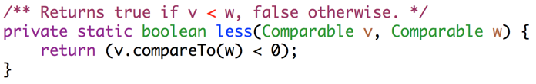
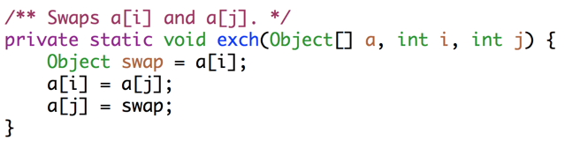
Utility Methods For Sorting

Slide 67
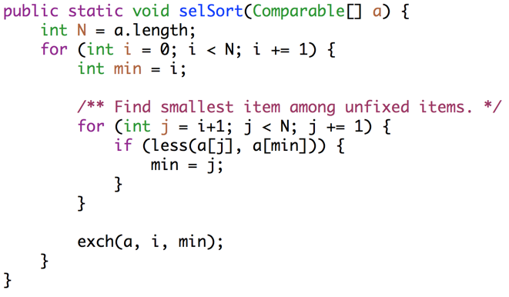
Selection Sort
Key ideas: Among unfixed items, find minimum in Θ(N) time and swap to the front. Subproblem has size N-1. Total runtime is N + N-1 + … + 1 = Θ(N²).

Slide 68
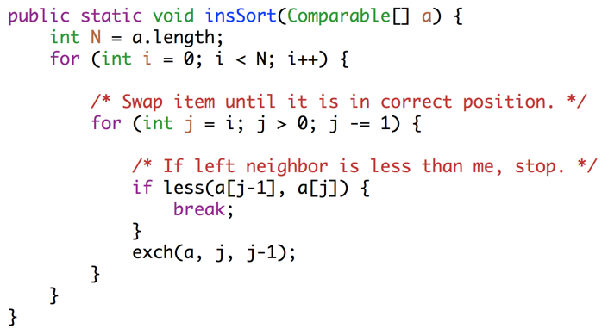
Insertion Sort
Key ideas: For each item (starting at leftmost), swap leftwards until in place. For item k, takes Θ(k) worst case time. Runtime is 1 + 2 + … + N = Θ(N²).

Slide 69
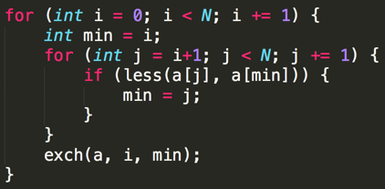
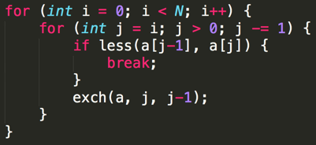
Selection and Insertion Sort Runtimes (Code Analysis)
Selection sort: Runtime is independent of input, always Θ(N²).
~N²/2 compares and ~N²/2 exchanges. Θ(N²) runtime.
Insertion sort: Runtime is strongly dependent on input. Ω(N), O(N²)
Best case (sorted): ~N compares, 0 exchanges: Θ(N)
Worst case (reverse sorted): ~N²/2 compares, ~N²/2 exchanges: Θ(N²)

Slide 70
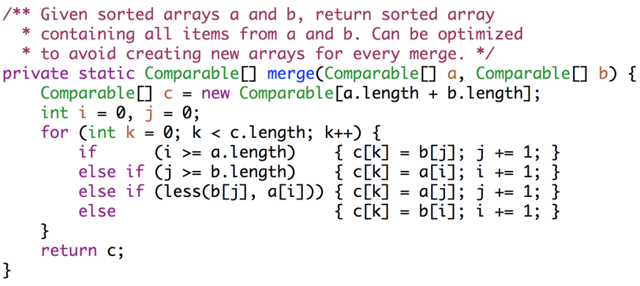
Mergesort (Merge Method)

Slide 71
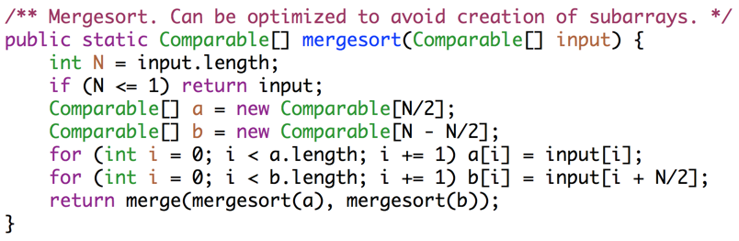
Mergesort
Key ideas: Each merge costs Θ(N) time and Θ(N) space, and generates two subproblems of size N/2. At level L of the sort, there are 2^{L} subproblems of size N/2^{L}. Since L = Θ(log N), runtime is Θ(N log N).

Slide 72
Interview Question
How can the above mergesort implementation be improved?
Try and avoid making copies a and b, by adding parameters to the merge routine. merge(input, 0, 5, 6, 10);
Use a diferent for small N: Like maybe insertion sort. Industrial strength mergesorts, use insertion sort for N < 15.

Slide 73
Interview Question
How can the above mergesort implementation be improved?

Slide 74
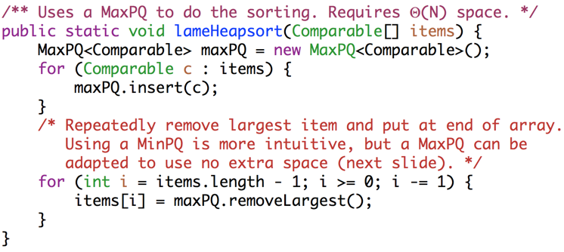
Heapsort With Separate PQ
Key ideas: Create a max heap of all items [Θ(N log N)], then delete max N times [Θ(log N) per delete]. Requires Θ(N) space.

Slide 75
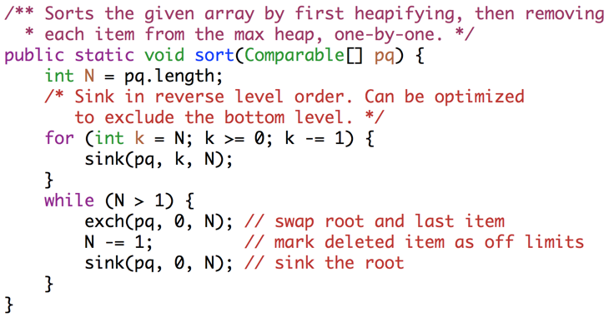
In-Place Heapsort (with root in position 0).
Key ideas: Max-Heapfiy [Θ(N)], then delete max N times [Θ(log N) per delete]

Slide 76
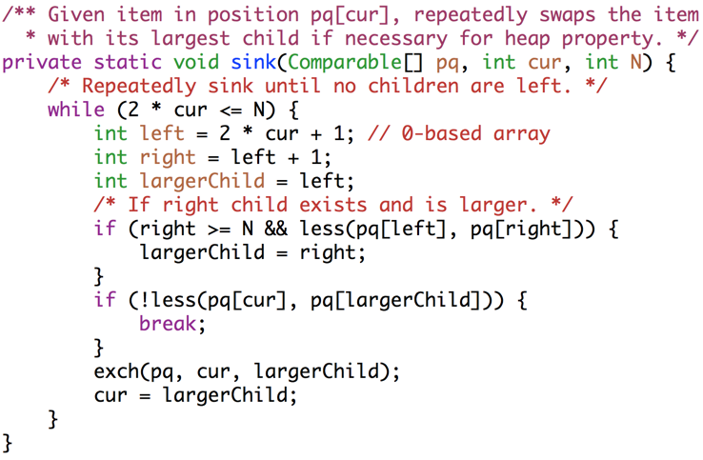
In-Place Heapsort Sink Operation (with root in position 0).

